Slide 1
OOPS (Object oriented Programing)

Slide 2
What is OOPs
OOP is a coding Methodology/Style
Makes our code more modular and reusable
Makes our code easier to maintain
Makes it easier to maintain
Makes it easier to debug when things goes wrong.

Slide 3
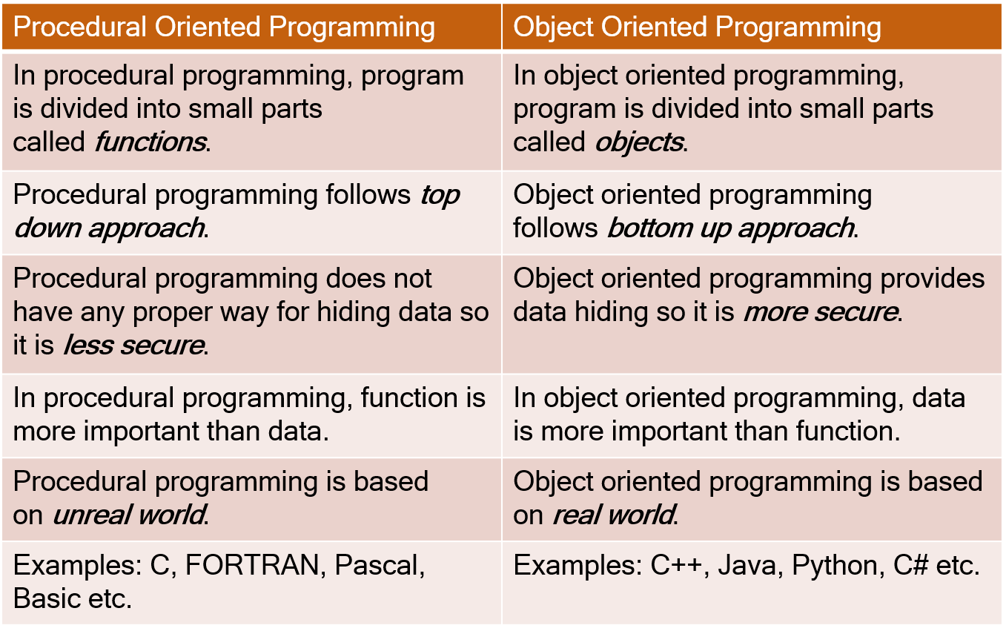
OOPs vs Procedural programing

Slide 4
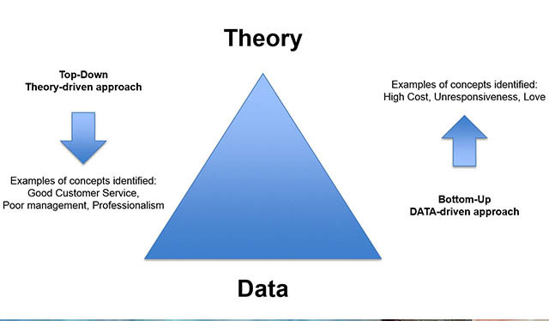
Top to Bottom vs bottom up

Slide 5
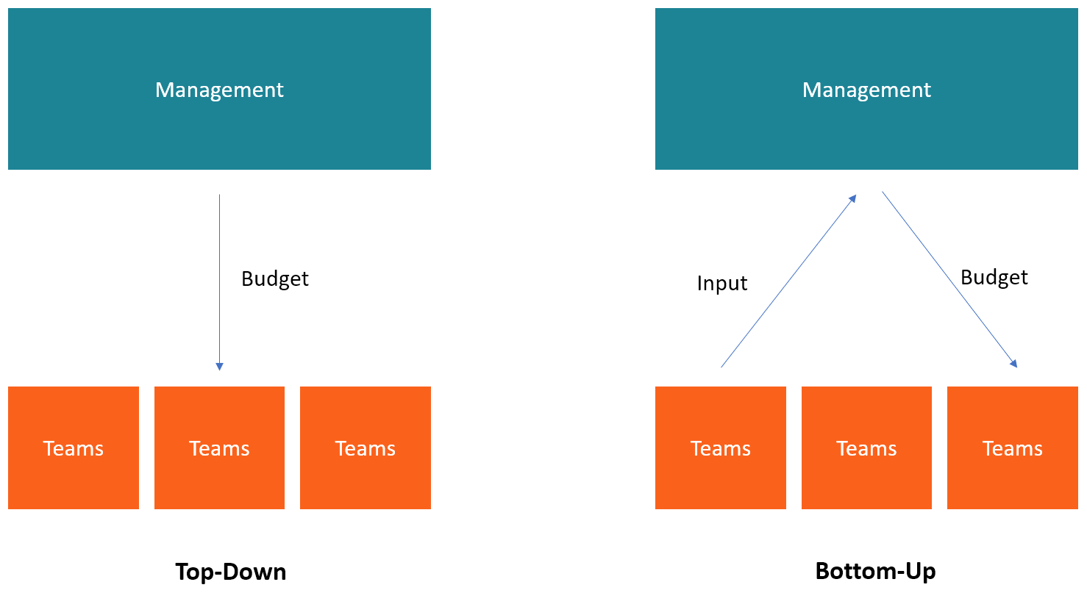
Top to Bottom vs bottom up

